Slide 1

Welectricity
by
Ninja Hertz
NWEN 304/MDDN 352 2015 T1
Designers: Nicola Roundill, Nicolas Hamilton, Josh Bottomley-Clapp
Engineers: John Armstrong, Tianfu Yuan (Tony)

Slide 2
Energy
It’s great

Slide 3
The Problem:
Energy is really popular
Energy demand
Energy production
Environment
Notes:
JOHN!?
Energy demand - The demand for energy is only going to increase
Population growth
More and more energy consuming devices and more power hungry devices
Energy production - The problems with meeting this ever increasing demand for energy
Need to keep up with demand
Will run out of fossil fuels
Renewable may not be able to meet demand yet
Environment - The effects of keeping up with the demand in energy
Climate change
Energy security

Slide 4


The energy of the future depends on the kids of today!
Notes:
JOHN!?
Energy demand - The demand for energy is only going to increase
Population growth
More and more energy consuming devices and more power hungry devices
Energy production - The problems with meeting this ever increasing demand for energy
Need to keep up with demand
Will run out of fossil fuels
Renewable may not be able to meet demand yet
Environment - The effects of keeping up with the demand in energy
Climate change
Energy security

Slide 5


Slide 6
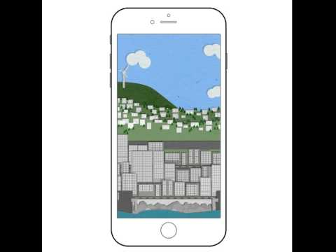

Slide 7

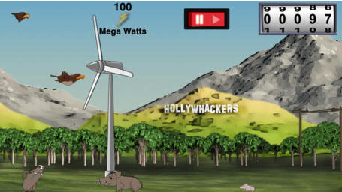
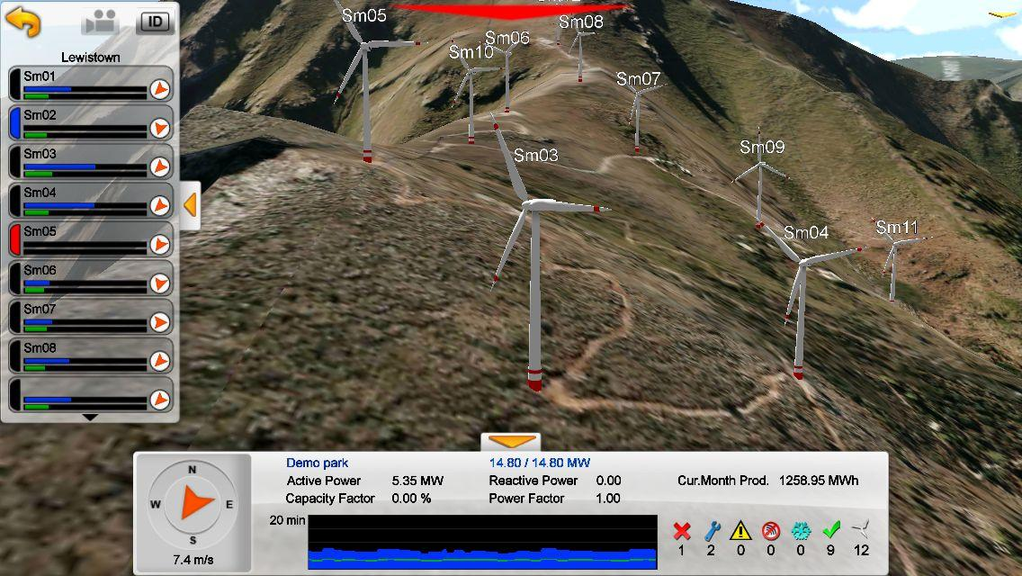
Competitors on the market:
Bax3DPlayer (Android business app)
(https://play.google.com/store/apps/details?id=com.baxenergy.bax3dplayer)
Wind Whackers (iOS game app)
(https://itunes.apple.com/us/app/wing-whackers/id529197631?mt=8)
Notes:
Tony
We try to find the same or similar apps on three largest mobile platform, which include Google Play for Android app, Apple App Store for iOS app and Microsoft Windows Phone Store for WP app. We found two similar apps on Android market, two similar apps on iOS market, and none of similar apps on WP market. Here I want to talk about two of similar apps that we found is related to our app.
One is called “Bax3DPlayer”, which is Android app, it was a business app to display real-time data from different wind farm in Europe, the design is similar to us, but it only focus on the wind turbine.
Another one is called “Wind Whackers”, which is iOS app, it was a game app, but it not for educational purpose.
Next, I want to how betters we are on the market.
1) different power sources, like wind turbine, hydropower, nuclear power, etc. the final game score will depend on the how many electricity generated, the population of the city and the impact of the environmental pollution to the residents.
2) very simple design, kids just choose the power plant on screen, and then place on the map to wait (less than 10 minutes) get the final score and compete with their friends, but they can get basic information about power plant while they are waiting.
As a result, we probably could say we are the only kid’s educational game app on the market.

Slide 8
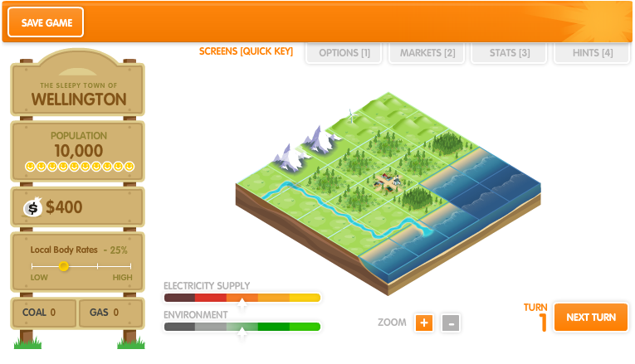


Other competitors:

Slide 9
Monetary Gain?
No.

Slide 10
THE END
Thank you!

